Slide 1
Transmission Line Equation
General Solution

Slide 2
Transmission-Line Theory
Lumped circuits: resistors, capacitors, inductors
neglect time delays (phase)
Distributed circuit elements: transmission lines
account for propagation and time delays (phase change)
We need transmission-line theory whenever the length of a line is significant compared with a wavelength.

Slide 3
Transmission Line
2 conductors
4 per-unit-length parameters:
C = capacitance/length [F/m]
L = inductance/length [H/m]
R = resistance/length [Ω/m]
G = conductance/length [ /m or S/m]
Ω
Δz
Note that these parameters are very low when the input voltage is DC or operating at low frequency, thus they can be ignored!

Slide 4
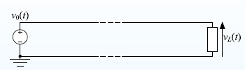
assume that any change in v₀(t) appears instantly at v_{L}(t).
This is not true.
If fact signals travel at around half the speed of light (c = 30 cm/ns).
Reason: all wires have capacitance to ground and to neighbouring conductors and also self-inductance. It takes time to change the current through an inductor or voltage across a capacitor.
A transmission line is a wire with a uniform goemetry along its length: the capacitance and inductance of any segment is proportional to its length.

Slide 5
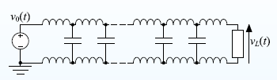
A transmission line is a wire with a uniform goemetry along its length: the capacitance and inductance of any segment is proportional to its length. We represent as a large number of small inductors and capacitors spaced along the line.
The signal speed along a transmisison line is predictable.

Slide 6
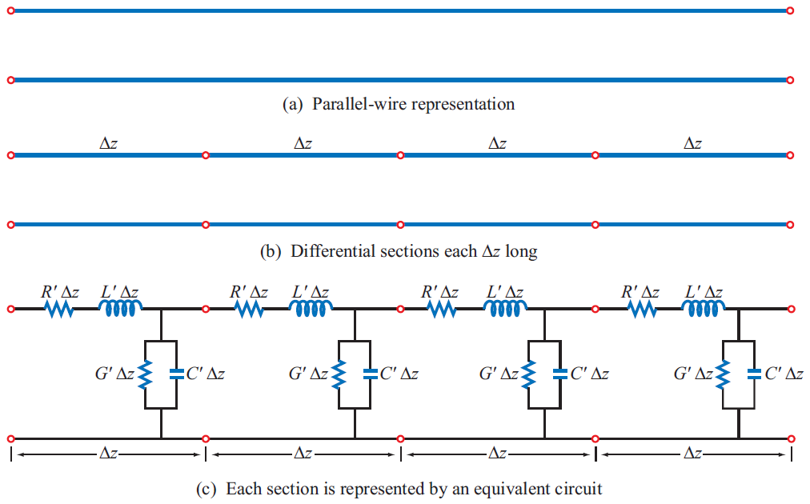
Transmission Line Model

Slide 7
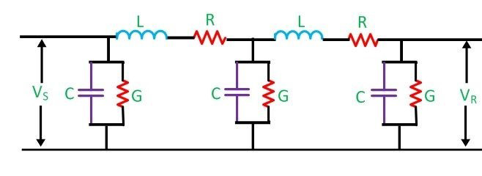
TRANSMISSION LINE PARAMETERS

Slide 8
Transmission Line (cont.)
x
x
x
+ + + + + + +
B
- - - - - - - - - -
i(z,t)
RΔz
LΔz
i(z+Δz,t)
+
+
v(z,t)
GΔz
CΔz
v(z+Δz,t)
-
-
z

Slide 9
Transmission Line (cont.)
i(z,t)
RΔz
LΔz
i(z+Δz,t)
+
+
v(z,t)
GΔz
CΔz
v(z+Δz,t)
-
-
z

Slide 10
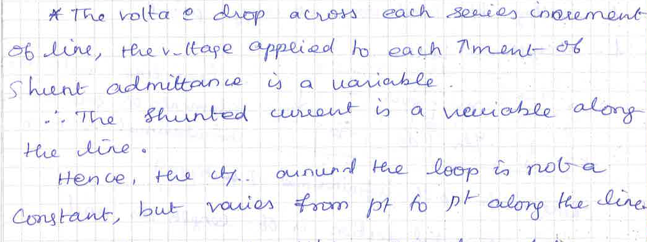

Slide 11
Energy Loss
As the wave propagates it may looses energy
Ohmic Loss: Due to resistance of the wire; at high frequency current flows outside the surface of the conductor
Skin Effect (thus circumference is critical)
Dielectric Loss: Energy is lost in dielectric
Converted to heat! The best dielectric is air!
How much energy is lost
Measured in dB/unit_of_length
dB_{gain} =10log(P_{out} / P_{in} )

